Slide 1
FT590 Week2

Slide 2
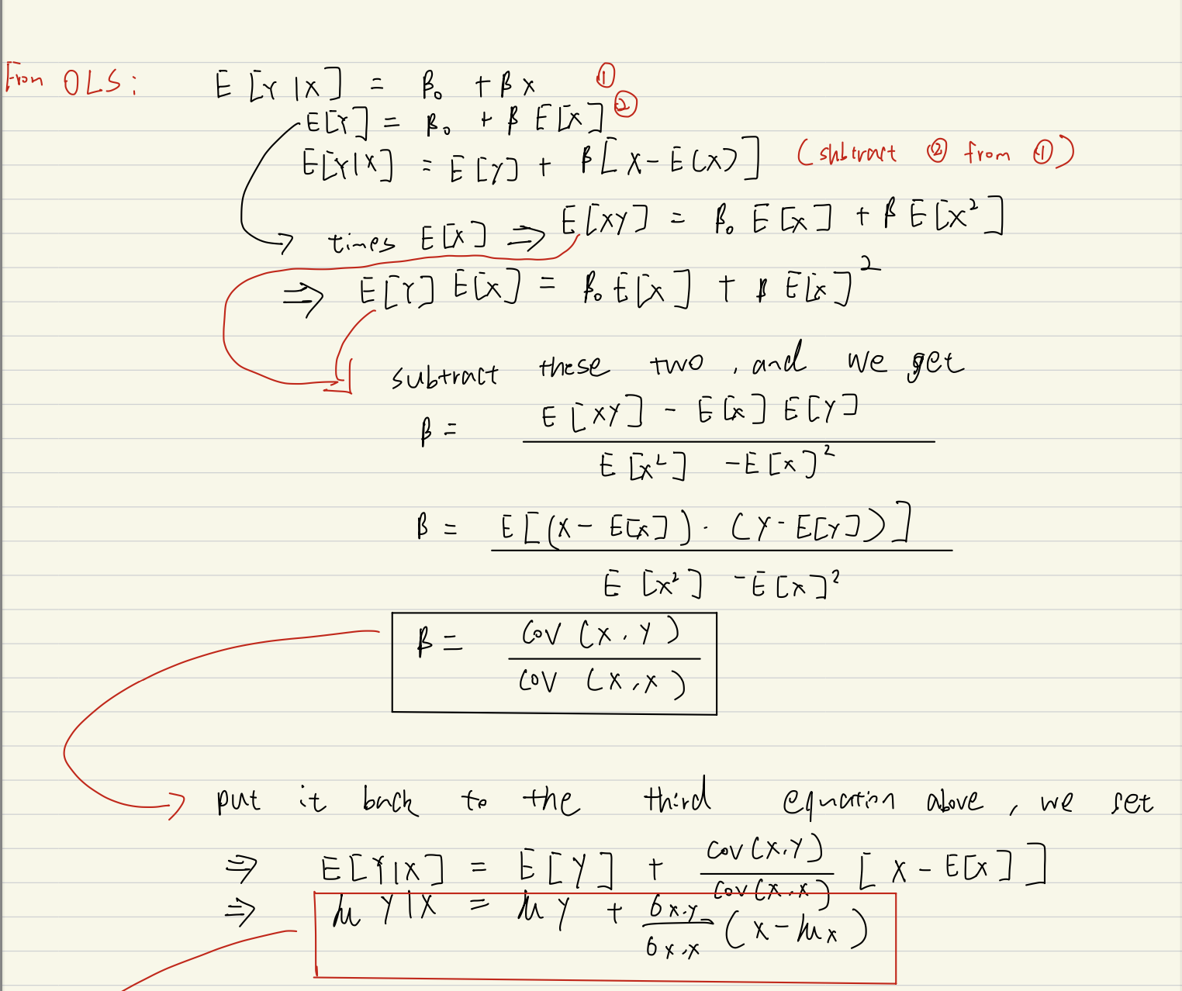
Problem 1

Slide 3
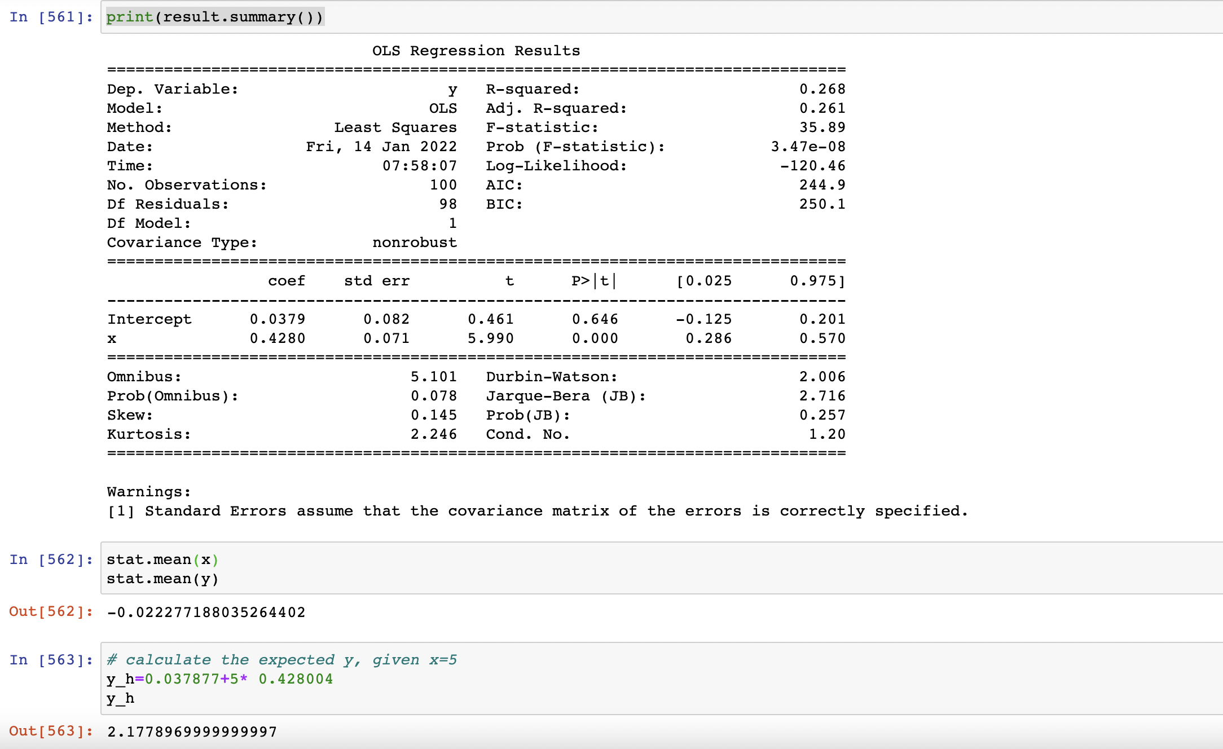

Slide 4
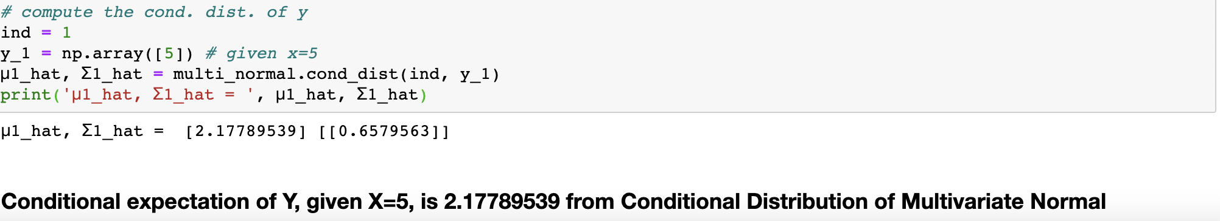
Conclusion: These two equations are the same thing

Slide 5
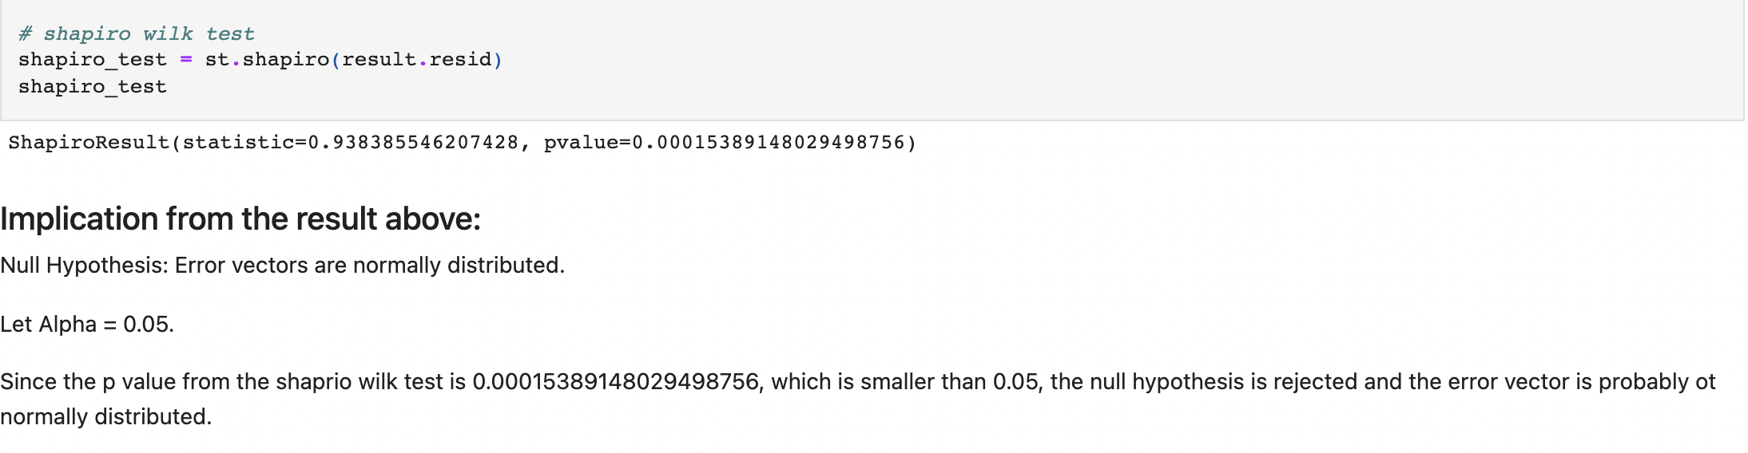
Problem 2

Slide 6
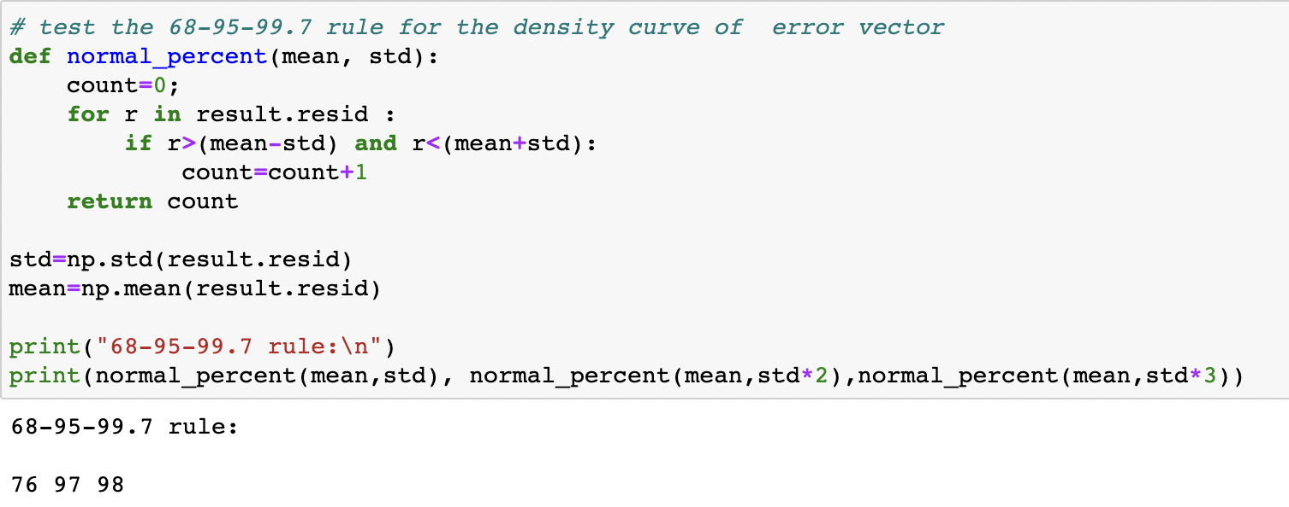
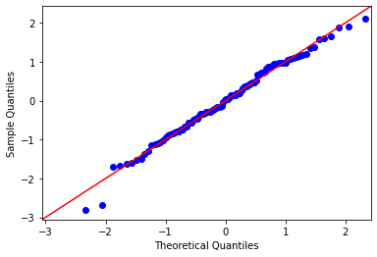
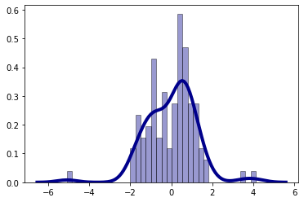

Slide 7
Conclusion: The error vector is probably not normally distributed

Slide 8
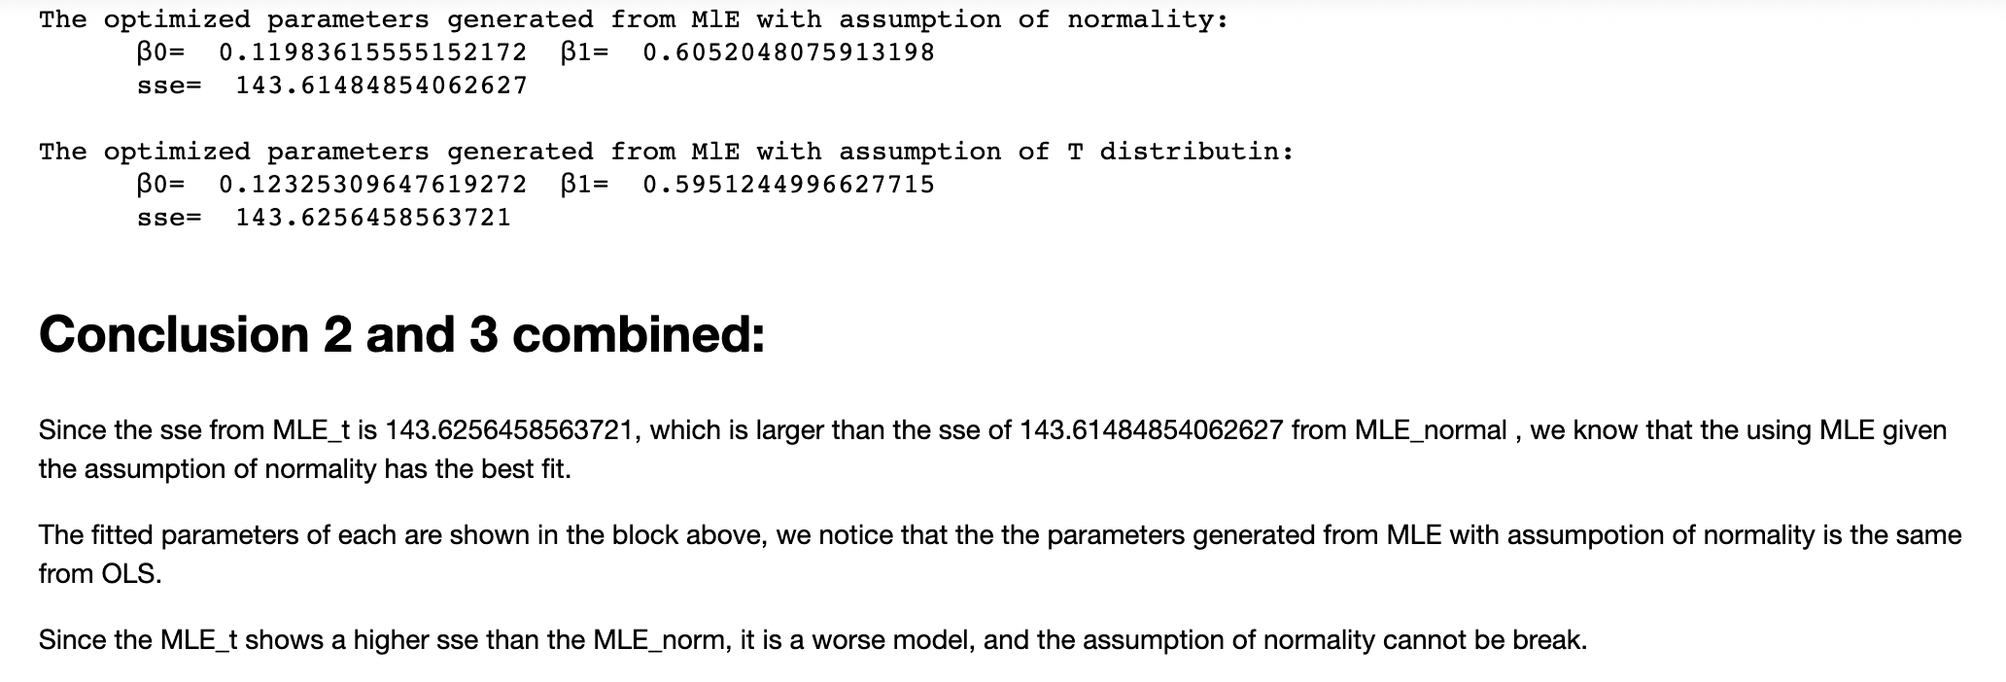

Slide 9
Problem 3
AR(1)-AR(3)

Slide 10
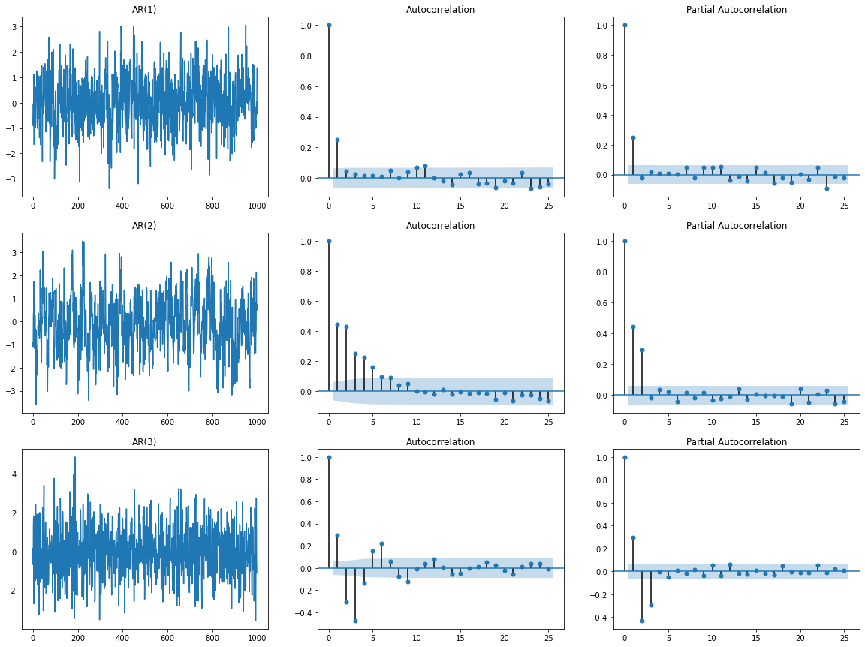

Slide 11
Problem 3
MA(1)-MA(3)

Slide 12
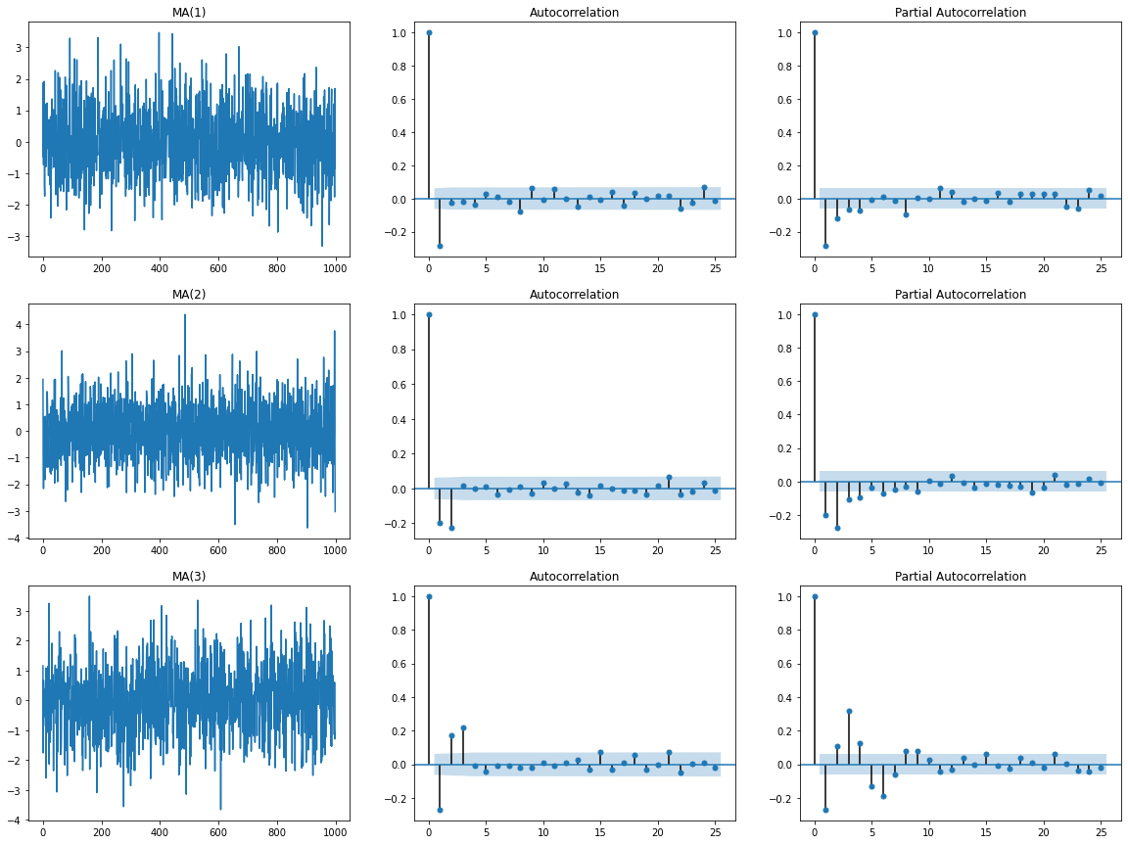

Slide 13
Identify Type and Order
When there is no clear pattern of the ACF but the first n lags of the PACF is significantly different from 0 and the significance of the rest of the lags decrease intensely, then this might be an AR(n) process.
On the other hand, when there is no clear pattern of the PACF but the first n lags of the ACF is significantly different from 0 and the significance of the rest of the lags decrease intensely, then this might be a MA(n) process.

